Slide 1
Fern’s Meadow
Social Media Calendar
June 14-June 21
Emma Richardson
ICM 522-De // Module 4

Slide 2
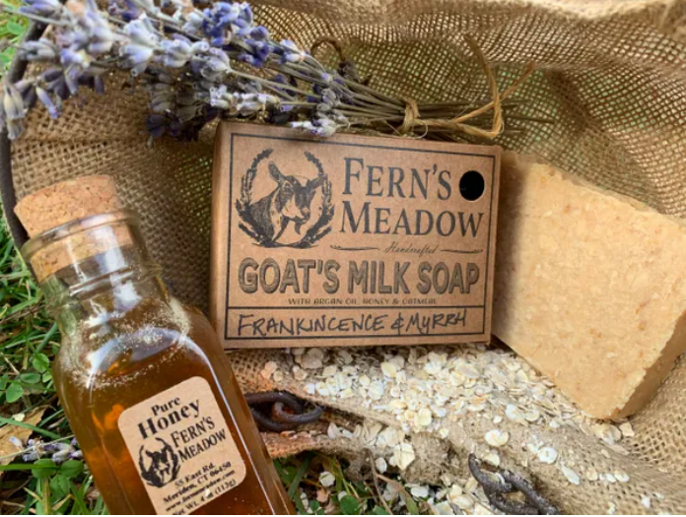
Sunday, June 14
Facebook
Topic: Artisan Products
Target Audience: Locals, 20+ y/o
Text:
We worked for months on end to get the perfect recipe for out handcrafted goats milk soap – and we love how it turned out.
The soap comes in a variety of wonderful smells, including Sandalwood and Frankincense & Myrrh – fragrances perfect for a father’s day gift!
You can buy our soap and other artisan goods on our website.
Link:
https://fernsmeadow.com/shop?olsPage=products%2Fgoats-milk-soap
RESULTS: TBD

Slide 3
Sunday, June 14
Pinterest
Topic: Artisan Products
Target Audience: Wives, Daughters 20+ y/o
Caption:
Father’s Day gift idea! Handcrafted Goats Milk Soap.
Link:
https://fernsmeadow.com/shop?olsPage=products%2Fgoats-milk-soap
RESULTS: TBD

Slide 4
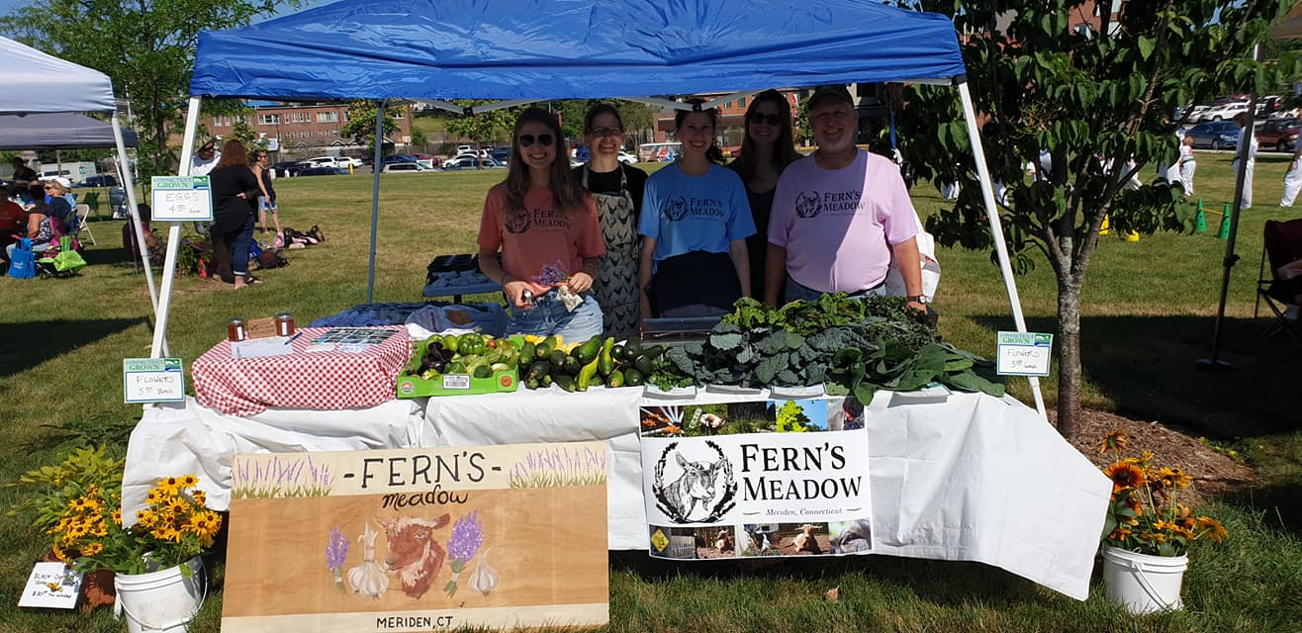
Monday, June 15
Facebook
Topic: Produce
Target Audience: Locals, 25+ y/o
Text:
Even though Farmer’s Markets won’t start until July, remember that you can still join our email list for fresh produce pick-up!
Message us here or email info@fernsmeadow.com to know what’s available.
RESULTS: TBD

Slide 5
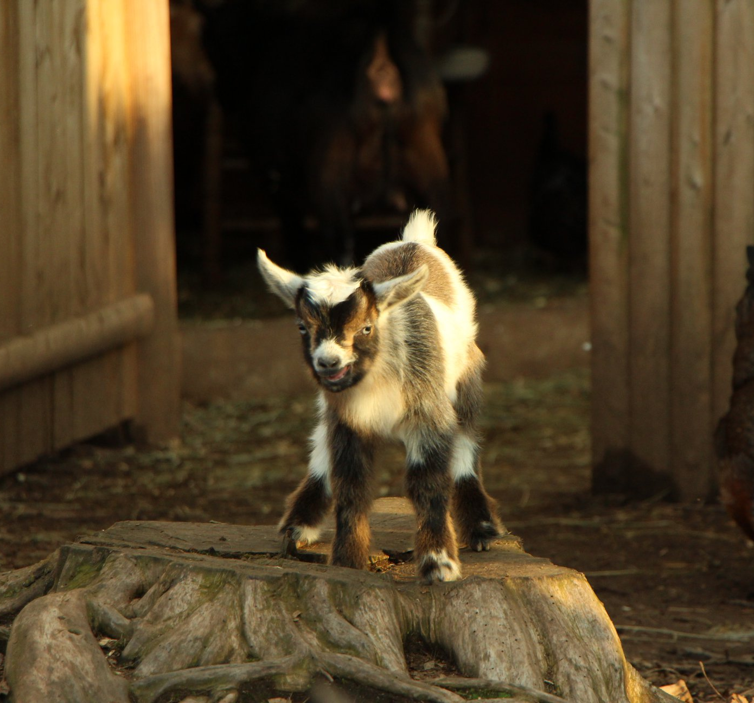
Monday, June 15
Pinterest
Topic: Animals
Target Audience: Women, 16-60 y/o
Caption:
Cute goat pictures to lift your spirits!
Link:
https://www.facebook.com/pg/fernsmeadow/photos/?tab=album&album_id=3237208629838428
RESULTS: TBD

Slide 6
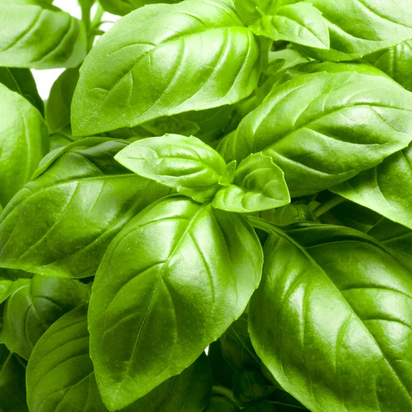
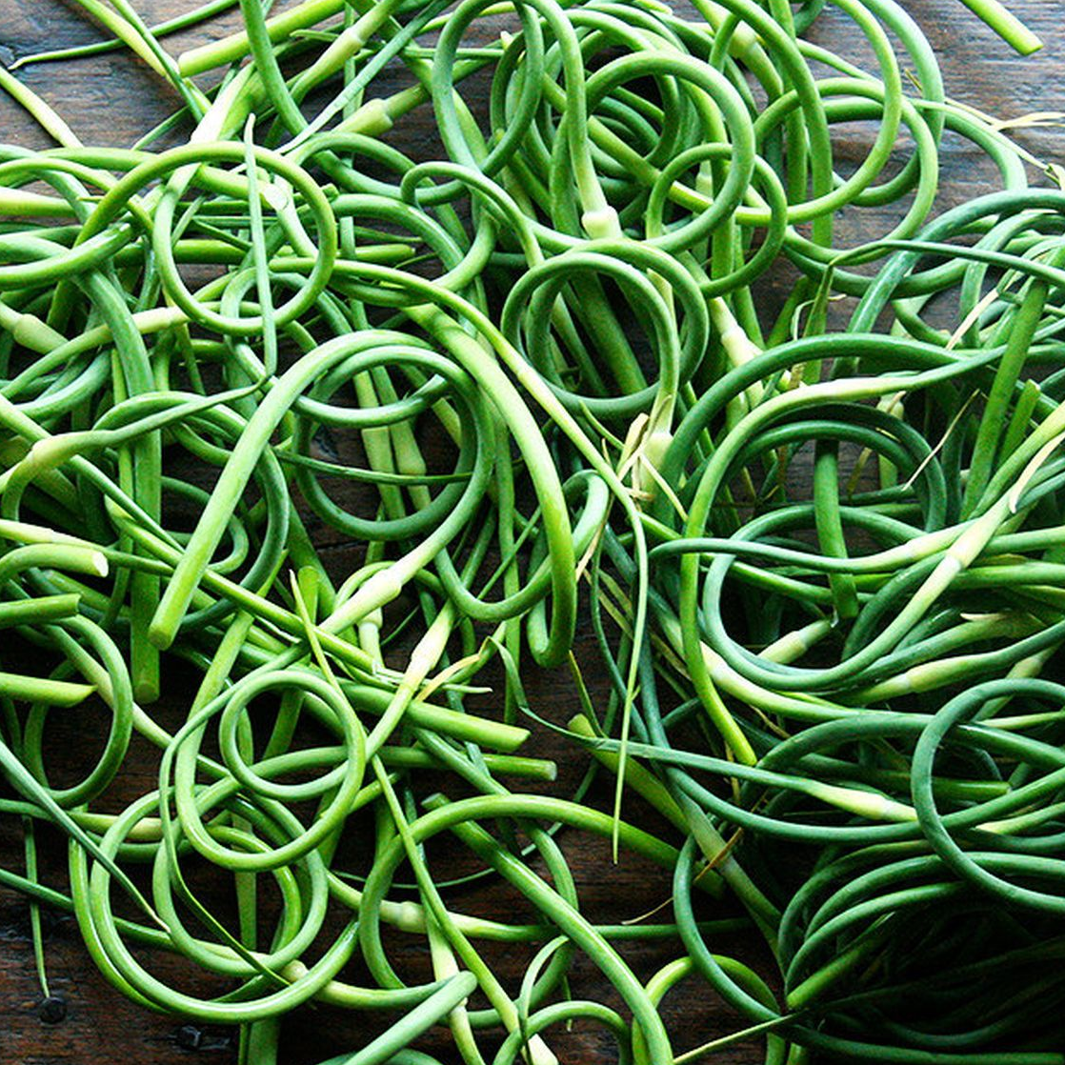
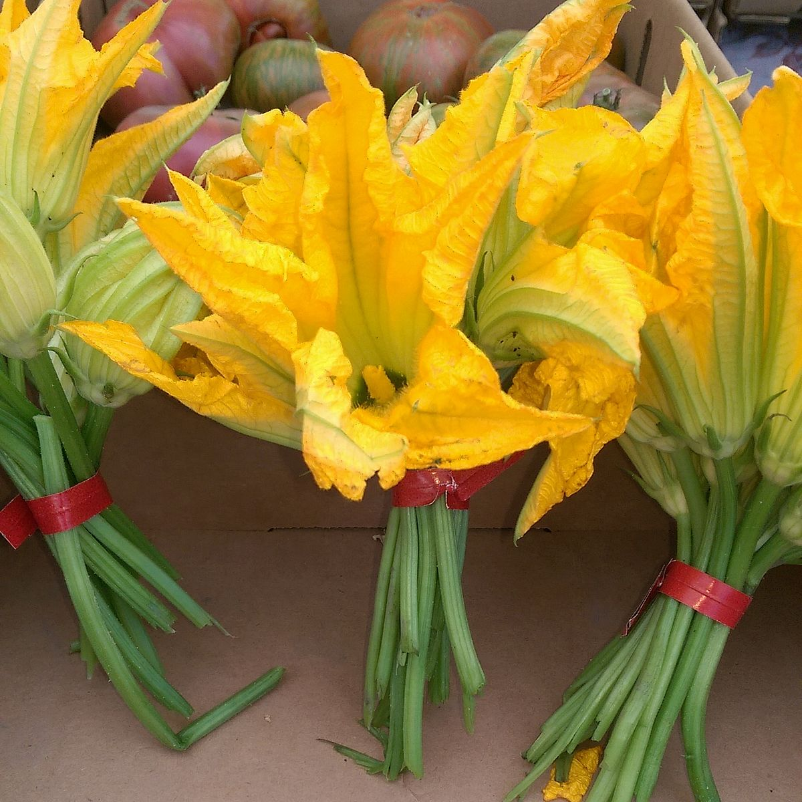
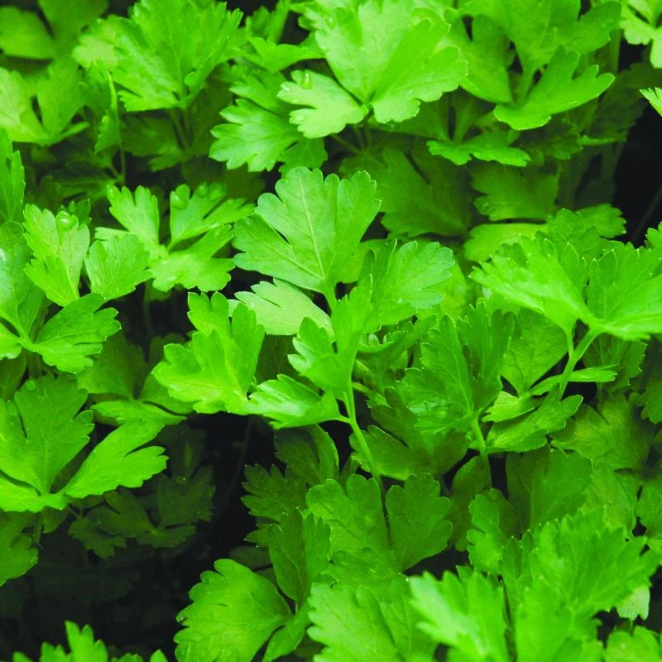
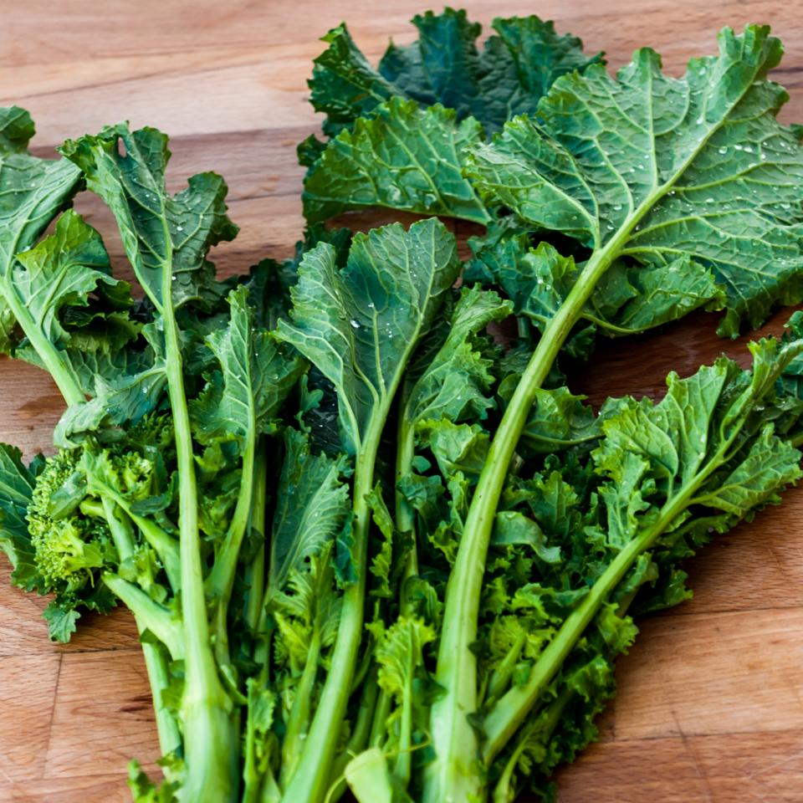
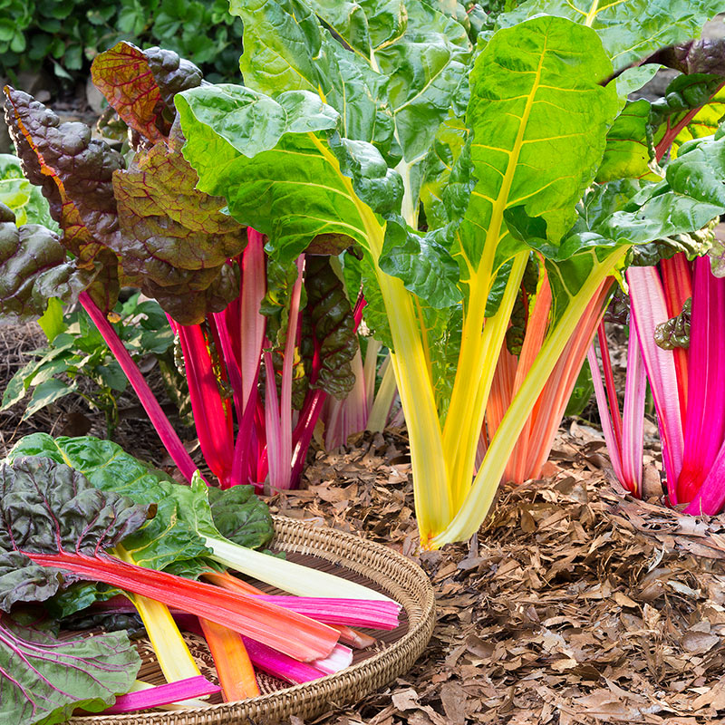
Tuesday, June 16
Facebook
GARLIC
SCAPES
BASIL
Topic: Produce
Target Audience: Locals, 20+ y/o
Text:
Happy Fresh Veggies Day! Which of these in-season produce is your favorite? (with poll)
NOTE: Substitute images.
RESULTS: TBD
SQUASH
FLOWERS
PARSLEY
TURNIP
GREENS
SWISS
CHARD

Slide 7
Tuesday, June 16
Pinterest
GARLIC
SCAPES
BASIL
Topic: Produce
Target Audience: Locals, 20+ y/o
Caption:
What’s in season at Fern’s Meadow!
Link:
https://fernsmeadow.com/contact-us
NOTE: Substitute images.
RESULTS: TBD
SQUASH
FLOWERS
PARSLEY
TURNIP
GREENS
SWISS
CHARD

Slide 8
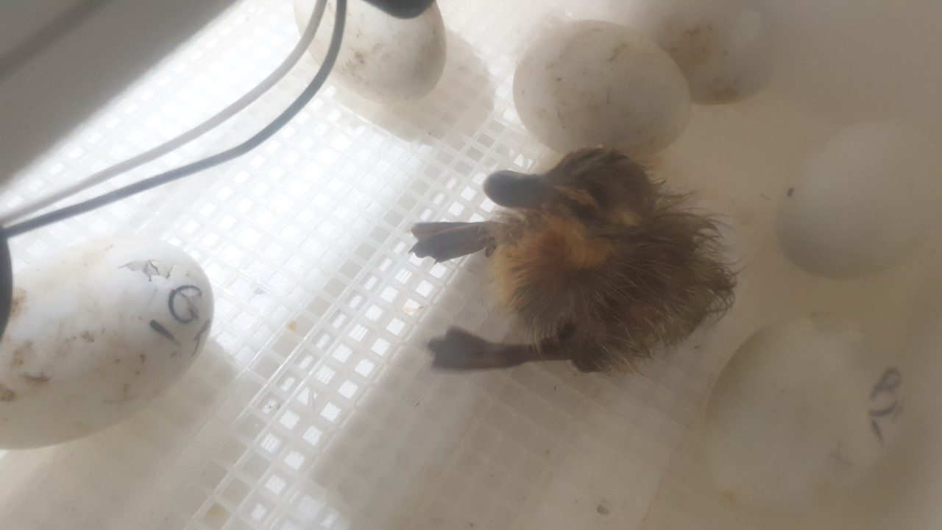
Wednesday, June 15
Facebook
Topic: Animals
Target Audience: General
Text:
Say hi to Puddles, Arthur, Scoot, Webber, and Dorothy!
They are all Ruin ducks, the same breed that won us Champion Fowl at many of the fairs last year.
Note: I will have a more clear and higher quality image of all 5 ducklings.
RESULTS: TBD

Slide 9
Wednesday, June 15
Pinterest
Topic: Animals
Target Audience: General
Text:
Fern’s Meadow how has 5 more Ruin ducklings!
Link:
https://fernsmeadow.com/
Note: I will have a more clear and higher quality image of all 5 ducklings.
RESULTS: TBD

Slide 10
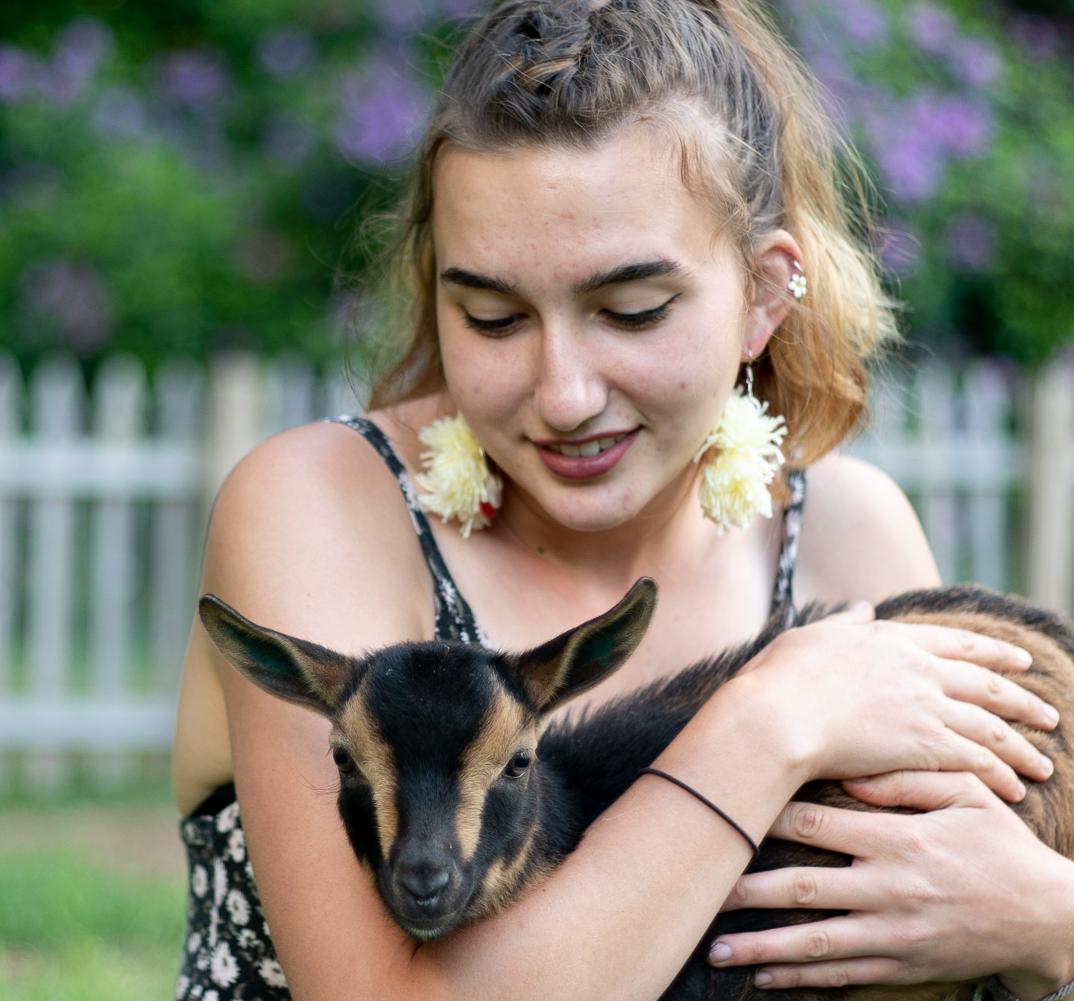
Thursday, June 18
Facebook
Topic: Animals/local business
Target Audience: Women, 20+ y/o
Text:
Our little Luna is a model!
She decided to help out with the local nonprofit fashion company Choose Your Battle’s photoshoot.
Tag:
https://www.facebook.com/chooseyourbattle19/
RESULTS: TBD

Slide 11
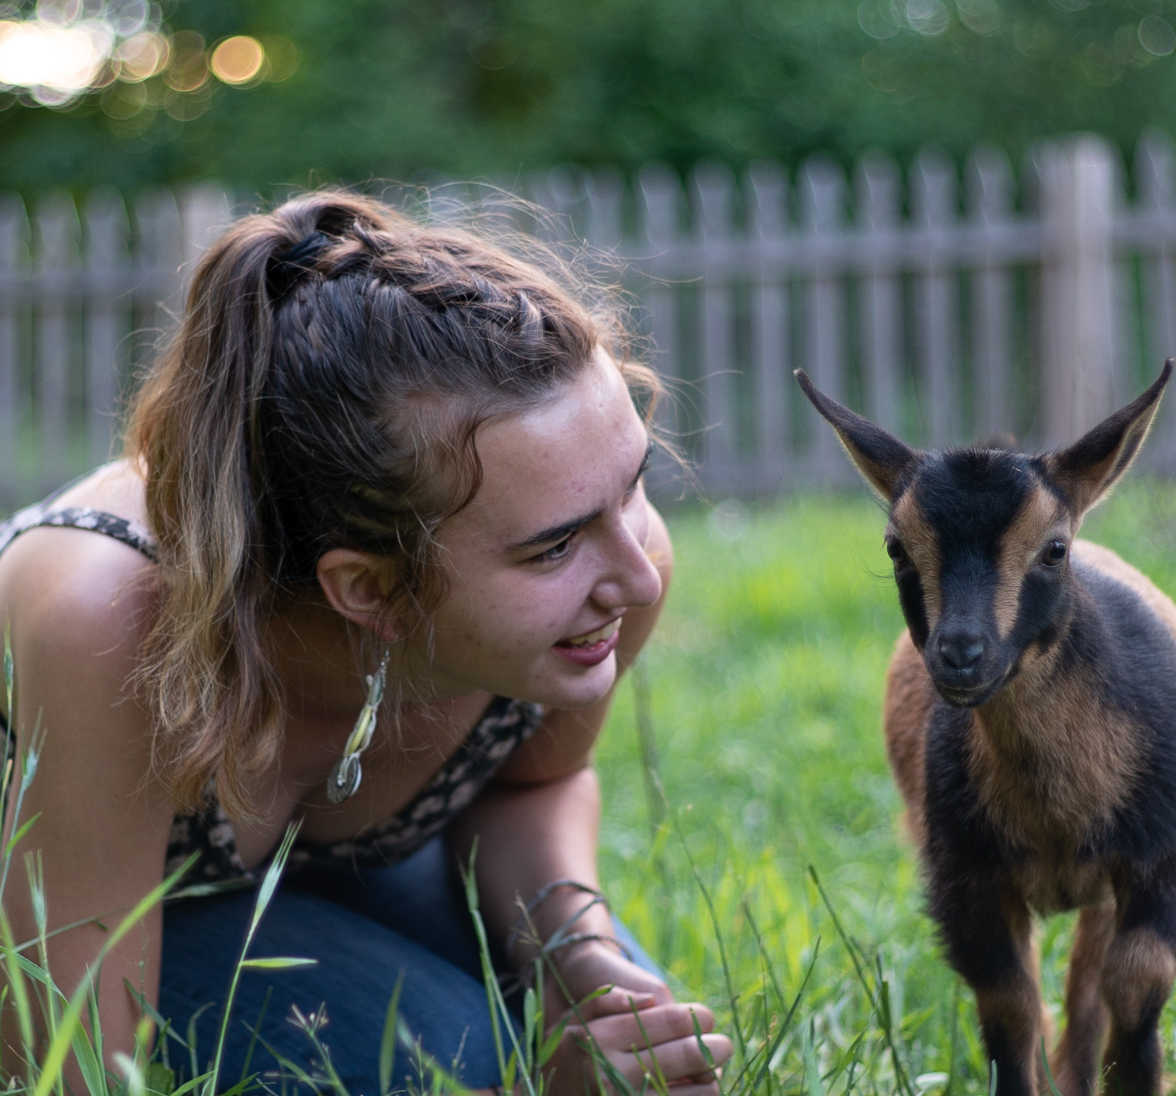
Thursday, June 18
Facebook
Topic: Animals/local business
Target Audience: Women, 20+ y/o
Text:
Fern’s Meadow loves local business! Our little Luna was a model for the nonprofit Choose Your Battle.
Link:
https://www.facebook.com/chooseyourbattle19/
RESULTS: TBD

Slide 12
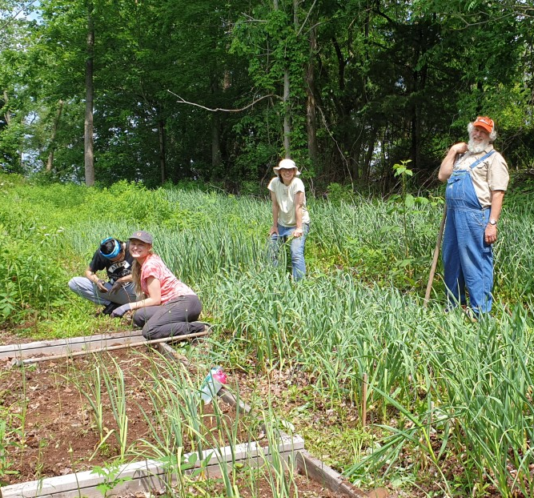
Friday, June 19
Facebook
Topic: Fern’s Family
Target Audience: Locals
Text:
The Fern’s Meadow crew is hard at work in the garlic fields!
Join our email list for info on garlic scape pickups and when garlic will be available later this year. Message us here or email info@fernsmeadow.com to stay updated.
RESULTS: TBD

Slide 13
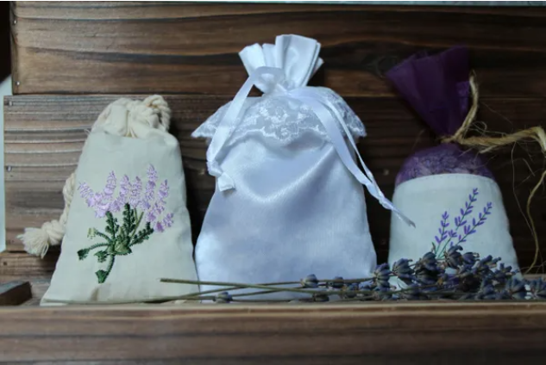
Friday, June 19
Pinterest
Topic: Artisan Products
Target Audience: Women, 25+ y/o
Caption:
Freshen up you home with some lavender saches – the perfect accent to your newly spring-cleaned home.
Link:
https://fernsmeadow.com/shop?olsPage=products%2Flavender-sachet
NOTE: will probably replace with better image.
RESULTS: TBD

Slide 14
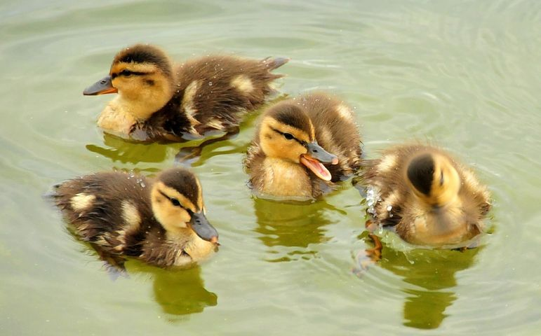
Saturday, June 20
Facebook
Topic: Animals
Target Audience: General
Text:
In this weather, these little ducklings have the right idea!
NOTE: This will be a video of our actual ducklings swimming.
RESULTS: TBD

Slide 15
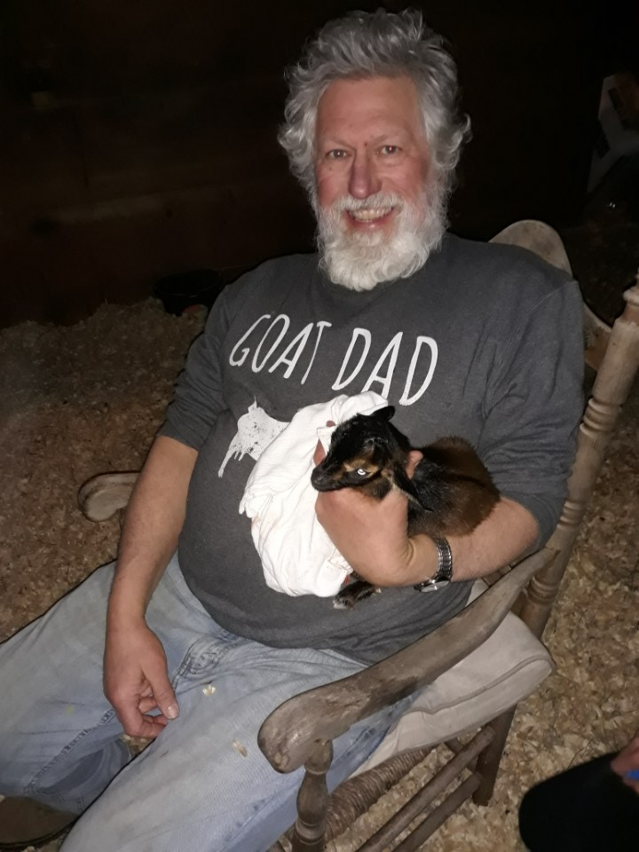
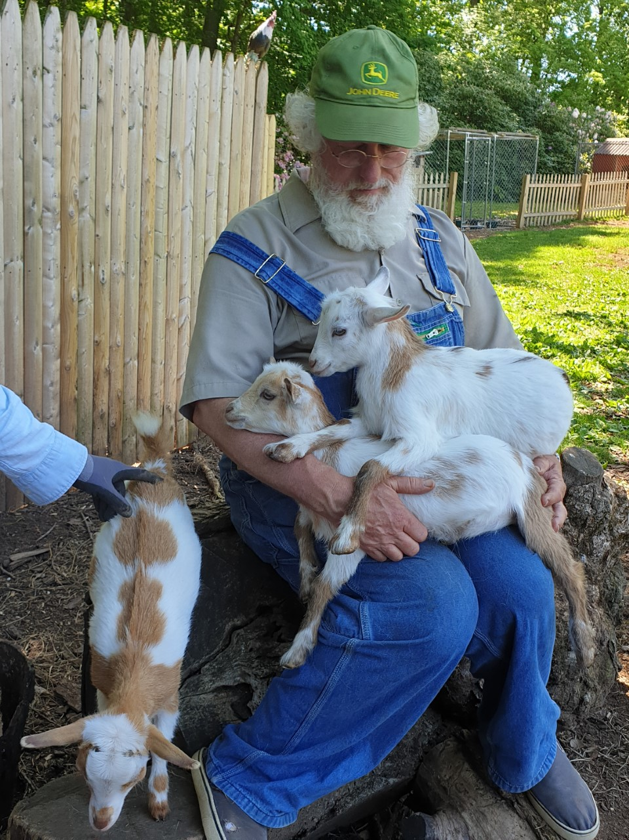
Sunday, June 21
Facebook
Topic: Fern’s Family/Animals
Target Audience: General
Text:
We at Fern’s Meadow wish a Happy Father’s Day to all of the dads (and goat dads) out there!
RESULTS: TBD

